Slide 1
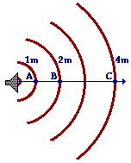
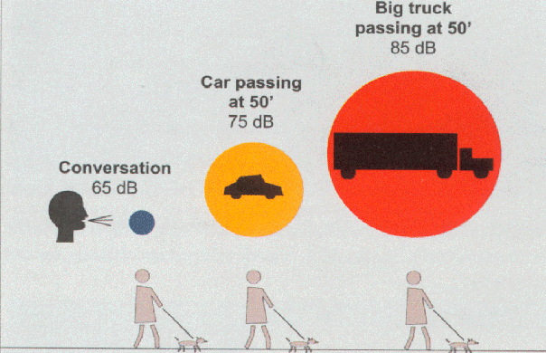
Understanding
Decibels
Sources: http://www.glenbrook.k12.il.us/gbssci/phys/Class/sound/u11l2b.html
http://www.oharenoise.org/Noise_101/sld008.htm
Notes:
Title page

Slide 2
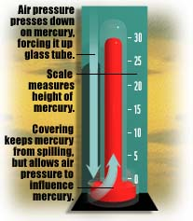
Air pressure and sound
Air pressure at sea level is about 101,325 Pascals (Pa) (about one “atmosphere”) or 14.7 pounds per square inch (psi) or 1 kg per square cm. This will register as 76 cm, or 760 mm, or 29.92 inches, of mercury on a mercury barometer.
Sources: http://www.usatoday.com/weather/wbaromtr.htm
http://www.valdosta.edu/~grissino/geog3150/lecture3.htm

Slide 3
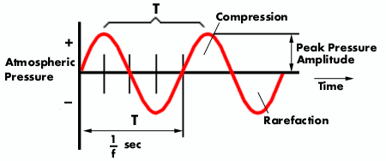
Micropascal and Pascal
The variations in air pressure that our ears hear as sound are very, very small, between 20 microPascals (μPa), or 0.00002 Pa (or newtons/m², or 0.0002 microbar or dyne/cm²), and 20 Pa.
Source: http://www.safetyline.wa.gov.au/institute/level2/course18/lecture53/l53_02.asp

Slide 4
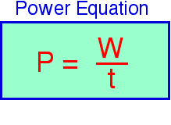
Power and watts
Power, or sound energy (w = work) radiated by a source per unit of time, is measured in watts.
Source: http://www-ed.fnal.gov/ntep/f98/projects/nrel_energy_2/power.html

Slide 5
Watt and Picowatt
The faintest sound we can hear, 0.00002 Pa, translates into
10⁻¹² (0.000000000001) watts, called a picowatt. The loudest sound our ears can tolerate, about 20 Pa, is equivalent to 1 watt.

Slide 6



Power comparison:
London to New York
The physicist Alexander Wood once compared this range from loudest to quietest to the energy received from a 50 watt bulb situated in London, ranging from close by to that received by someone in New York.
Source: http://www.sfu.ca/sonic-studio/handbook/Decibel.html

Slide 7

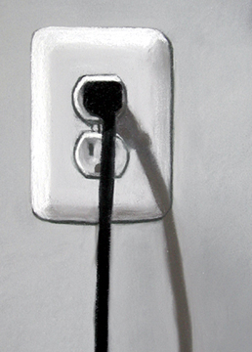

Power comparison:
Voices powering a light bulb
  It has been estimated that it would take more than 3,000,000 voices all talking at once to produce power equivalent to that which can light a 100 watt lamp.
  Source: Fry, D. B. 1979. The Physics of Speech. Cambridge: UP. p. 91

Slide 8
Pressure and amplitude
Amplitude is the objective measurement of the degree of change (positive or negative) in atmospheric pressure (the compression and rarefaction of air molecules) caused by sound waves. The amplitude of a pendulum swinging through an angle of 90° is 45°. It is half of the maximum pressure change in the air as the sound wave propagates.
Source: http://www.indiana.edu/~emusic/acoustics/amplitude.htm

Slide 9
Intensity
The density of power passing through a surface perpendicular to the direction of sound propagation is called sound intensity, and it is usually measured in watts.
Or, if we picture a sound wave as an expanding sphere of energy, power is the total amount of kinetic energy contained on the sphere’s surface.
Sources: http://www.indiana.edu/~emusic/acoustics/amplitude.htm
http://fromdeathtolife.org/cphil/sound2.html

Slide 10
Intensity: Sound transmitted per unit time through a unit area
Intensity is measured in power per unit of area, i.e. watts/m² or watts/cm². Intensity is proportional to the square of the amplitude (A²). If you double the amplitude of a wave, i.e. if the ratio of the amplitudes of two sounds is 1:2, the ratio of the intensities is 1:4; tripling the amplitude results in a ratio of 1:9.

Slide 11
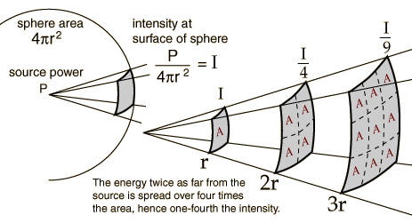
Intensity of a wave in a free field
The intensity of a wave in a free field drops off as the inverse square of the distance from the source.
Source: http://hyperphysics.phy-astr.gsu.edu/hbase/acoustic/invsqs.html

Slide 12
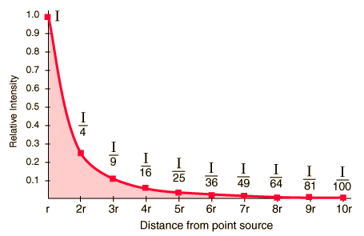
Inverse Square Law Plot
Source: http://hyperphysics.phy-astr.gsu.edu/hbase/acoustic/invsqs.html

Slide 13
Units of measurement
  sound pressure: The total instantaneous pressure at a point in space, in the presence of a sound wave, minus the static pressure at that point.
  sound pressure amplitude: Absolute value of the instantaneous pressure. Unit: Pascal (Pa)
  sound power: Sound energy (‘the ability to do work’)
  radiated by a source per unit of time. Unit: watt (W).
  sound intensity: Average rate of sound energy transmitted in a specified direction at a point through a unit area normal to this direction at the point considered. Unit: watt per square meter (W/m²) or square centimeter (W/cm²).
  sound pressure level: The sound pressure squared, referenced to 20 μPa² measured in dB. Commonly, how loud the sound is measured in decibels.
  Source: http://www.webref.org/acoustics/s.htm

Slide 14
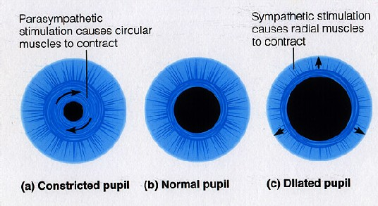
Our ears can compress sound waves
The muscles of the iris can contract or dilate the pupils to adjust the amount of light coming into our eyes. In an analogous way, the middle ear has a mechanism which can adjust the intensity of sound waves striking our eardrums. This adjustment enables us to discriminate very small changes in the intensity of quiet sounds, but to be much less sensitive to volume changes in louder noises. This means that the human ear can safely hear a huge range of very soft to very loud sounds.
Source: Everest, F. Alton. 2001. Master Handbook of Acoustics, 4th ed. New York: McGraw-Hill, pp. 41-48
Graphic: http://cs.swau.edu/~durkin/biol101/lecture31/

Slide 15
Logarithms and the decibel scale
If you hear a sound of a certain loudness, and then are asked to choose a sound that is twice as loud as the first sound, the sound you choose will in fact be about ten times the intensity of the first sound. For this reason, a logarithmic scale, one that goes up by powers of ten, is used to measure the loudness of a sound. The exponent of a number (here we use only 10) is its logarithm. Example of a base 10 logarithm:
10 x 10 x 10 x 10 = 10,000 = 10⁴
log₁₀ 10,000 = log 10,000 = 4
Here is an excellent tutorial to help you review (or learn for the first time!) logarithms:
http://www.phon.ucl.ac.uk/cgi-bin/wtutor?tutorial=t-log.htm

Slide 16
What is a decibel?
A decibel (dB) is a unit for comparing the intensity of two different sounds; it is not a unit of absolute measurement. The usual basis of comparison is a barely audible sound, the sound of a very quiet room, or 0.00002 Pa, at which 0 dB is set.

Slide 17

Bels and Decibels
The unit used to compare the intensity of sounds was originally the Bel (in commemoration of the work of Alexander Graham Bell), which was the logarithm of the intensity ratio 10:1. This unit was considered too large to be useful, so a unit one tenth the size of a Bel, the ‘decibel’ (dB), was adopted.

Slide 18
Calculating decibels
To compare the intensities of two sounds, I₁ and I₂, we place the larger value of the two in the numerator of this formula:
10 x log I₁/I₂ decibels (dB)
You will also see this formula calculated using amplitude (air pressure) instead of intensity, as
10 x log x₁²/x₂² decibels (dB), simplified to:
20 x log x₁/x₂ decibels (dB)
Example: What is the difference in decibels between 3.5 and 0.02 watts?
10 log 3.5/0.02 = 10 log (175) = 10 (2.24) = 22.4 dB difference
Source: http://www.ac6v.com/db.htm

Slide 19
A power ratio of 1:100
If the intensity of one sound is 100 times greater than that of another, then I₁/I₂ = 100; log 100 = 2.0 and 10 x 2.0 = 20 dB. An intensity ratio of 1:100 or 0.01 yields an amplitude ratio of 0.1 (√0.01 = 0.1).

Slide 20
A power ratio of 1:2
However, if you were to hear the noise of an air hammer, then the noise of a second air hammer were added to that, the increase in intensity would be only 3 dB, since it would only have an intensity ratio of 1 to 2, i.e. 0.50, and an amplitude ratio of 0.707.
(e.g. 40/20 = 2; log 2 = 0.301;
0.301 x 10 = 3dB; √0.5 = .707)

Slide 21
A power ratio of 1:4
A 6 dB change in intensity means an intensity ratio of 1 to 4, i.e. 0.25, with an amplitude ratio of 1 to 2 or 0.50.
(e.g. 100/25 = 4; log 4 = .602;
.602 x 10 = 6 dB; √0.25 = 0.5)

Slide 22

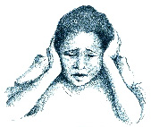
From softest to loudest
The intensity ratio between the faintest audible sound and the loudest sound we can tolerate is one to one trillion, i.e. 10¹²; the log of 10¹² is 12, and 12 x 10 = 120 decibels, the approximate range of intensity that human hearing can perceive and tolerate. The eardrum would perforate instantly upon exposure to a 160 dB sound.

Slide 23
How much is a trillion?
One trillion is one million millions, a 1 followed by 12 zeros:
1,000,000,000,000.
This comes out to a convenient number (though seldom-used because it is so large) in Chinese, which is organized in units of four zeros instead of three:
1,|000,0|00,00|0,000|.
What is this number called in Chinese?

Slide 24
Decibel levels of some common sounds
Sound Source | Sound Pressure Level (dB)
threshold of excellent youthful hearing | 0
normal breathing, threshold of good hearing | 10
soft whisper | 30
mosquito buzzing | 40
average townhouse, rainfall | 50
ordinary conversation | 60
busy street | 70
power mower, car horn, ff orchestra | 100
air hammer at 1m, threshold of pain | 120
rock concert | 130
jet engine at 30m | 150
rocket engine at 30m | 180
More decibel levels here: http://www.lhh.org/noise/decibel.htm

Slide 25
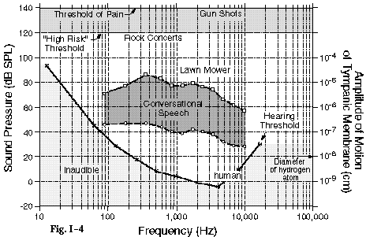
The Range of Human Hearing
Our sensitivity to sounds depends on both the amplitude and frequency of a sound. Here is a graph of the range of human hearing.

Slide 26
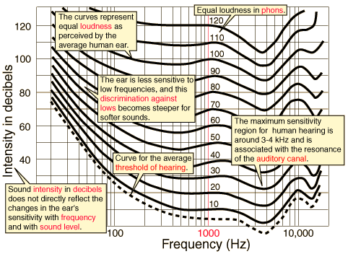
Annotated Equal Loudness Curves
Source: http://hyperphysics.phy-astr.gsu.edu/hbase/sound/eqloud.html#c1

Slide 27
SPL and SL
There are two common methods of establishing a reference level r in dB measurements. One uses 20 μPa of a 1,000 Hz tone; this is labeled dB SPL (‘sound pressure level’). The other method uses the absolute threshold frequency for a tone at each individual frequency; this is called dB SL (‘sensation level’).
Source: Johnson, Keith. 1997. Acoustic & Auditory Phonetics. Cambridge & Oxford: Blackwell. .p . 53

Slide 28
Increase in source power (watts) | Change in SPL (dB) | Change in apparent loudness
x 1.3 | 1 | smallest audible change in sound level, noticeable only if two sounds are played in succession
x 2 (doubled) | 3 | just perceptible
x 3.2 | 5 | clearly noticeable
x 4 | 6 | a bit less than twice as loud
x 10 | 10 | a bit more than twice as loud
x 100 | 20 | much louder
Sources: http://www.me.psu.edu/lamancusa/me458/3_human.pdf
& http://www.tpub.com/neets/book11/45e.htm
Audio demonstration: http://www.phon.ucl.ac.uk/courses/spsci/psycho_acoustics/sld008.htm

Slide 29
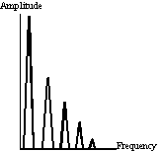
Amplitude of overtones
The harmonics or overtones (also called ‘partials’) of a sound decrease by 12 dB for each doubling of frequency (e.g. 100, 200, 400, 800, 1,600…) or each equivalent of a musical octave. In human speech, however, the lips act as a piston, and strengthen the amplitude of the speech signal (called the radiation factor or radiation impedance), adding back 6 dB to each octave. So the net decrease in amplitude of the overtones of a speech sound is 6 dB per octave.
Ladefoged, Peter. 1996. Elements of Acoustic Phonetics .Chicago and London: University of Chicago. P. 104.
Source: http://www.leeds.ac.uk/music/studio/teaching/audio/Acoustic/acoustic.htm

Slide 30
Frequency and decibels:
ranges and limits
Here is a link to a tone rising in frequency to cover much of the range of human hearing.
http://homepage.ntu.edu.tw/~karchung/rm_files/range.aiff
Here is a link to a tone going down progressively, first in 6 steps of 6 dB each, then again in 12 steps of 3 dB each.
http://www.sfu.ca/sonic-studio/handbook/Decibel.html

Slide 31
Decibels: links to explore
Wikipedia: Decibel
http://en.wikipedia.org/wiki/Decibel
How stuff works: What is a decibel…?
http://www.howstuffworks.com/question124.htm
Another “What is a Decibel?”
http://www.phys.unsw.edu.au/jw/dB.html
Sound pressure levels in decibels - dB
http://www.coolmath.com/decibels1.htm
Decibel calculator for adding decibels
http://www.jglacoustics.com/acoustics-dc_1.html

Slide 32
Enough on decibels for now!

